Slide 1


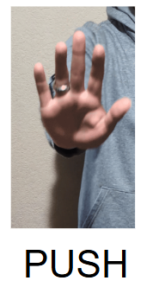
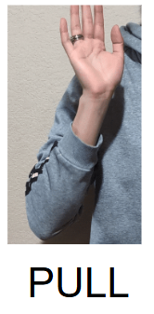
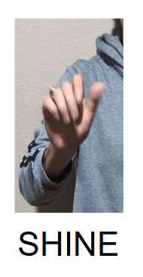
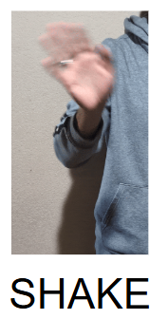
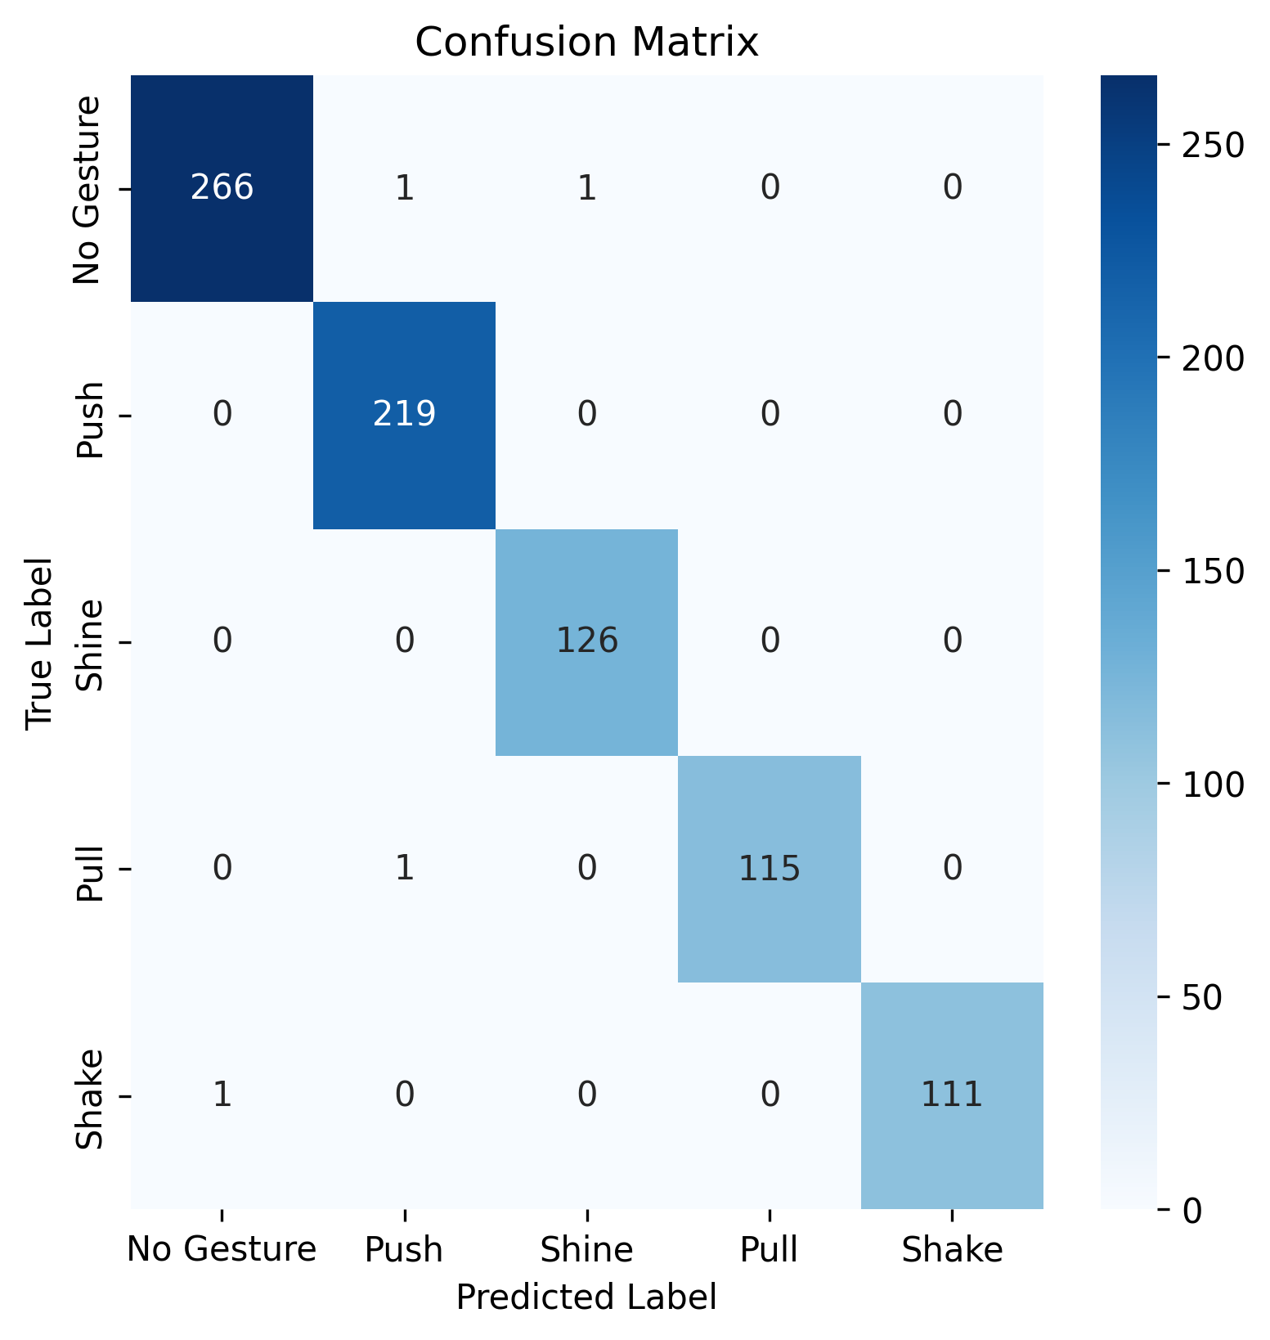
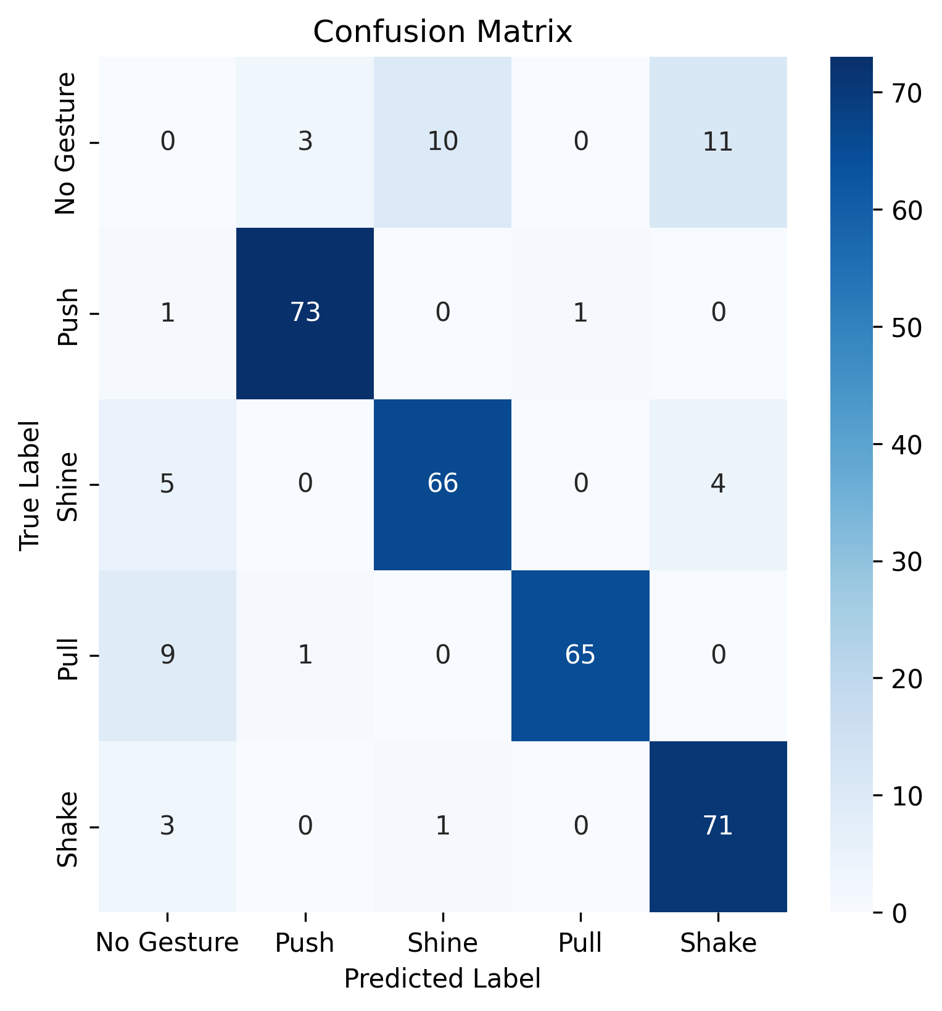
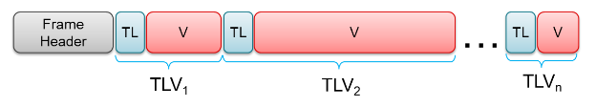
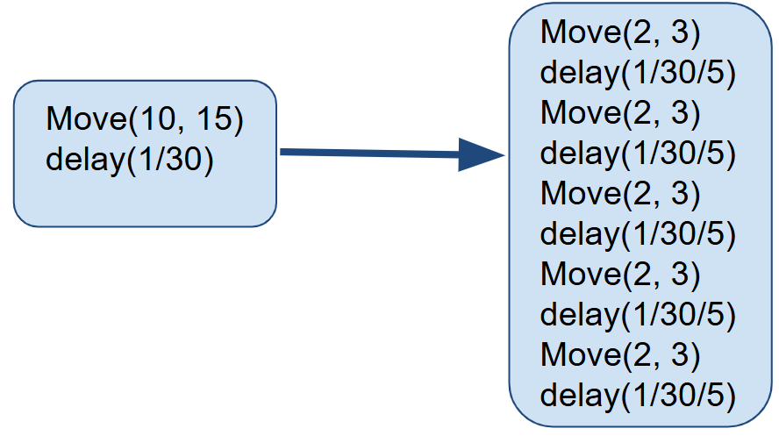
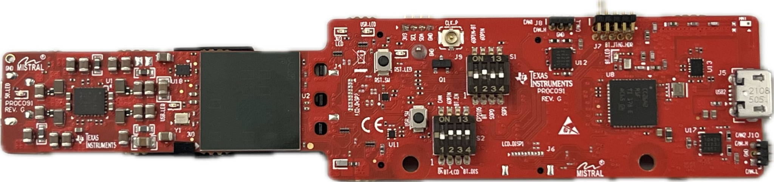
Booth Number: 350
Team 71: Virtual Computer Mouse using mmWave Radar
Oscar Chavez, Daniel Lu, Greyson Heath, Zane Meikle
Stavros Kalafatis
Problem Definition
A virtual mouse is generally implemented using computer vision algorithms with a camera. This project uses TI’s mmWave Radar to implement a virtual mouse while using less power and computer resources.
Data Collecting
Using a TI provided binary, which is the program that instructs the radar to perform specific calculations, the radar is effectively tuned to best detect a human hand. The radar operates at 30 FPS, and per frame a variable number of points are detected which are represented in a TLV (type-length-value) format. From these points the following information is extracted: X, Y, Z, and doppler.
The beginning of each frame header is denoted using TI’s “magic word”, a constant series of bits that represent a new frame. As the radar is running, this live-data is decoded and streamed for further processing.
Gesture Recognition
During each frame, the radar outputs 5 pieces of data; the number of points detected, the X,Y,Z position of each point, and the doppler (speed) associated with each point.
The CNN model implemented uses the average position (X,Y,Z), the average doppler, and the number of points in each frame as features. The model requires 30 frames of information to make a gesture prediction.
How to use
To use the radar, move your hand in front of the radar to move the mouse. To left click, right click, and scroll, use the gestures below in Figure 5. The gestures can be set to different action within the GUI window. As well, different algorithms for tracking your hand can selected in the GUI window.
Methodology
By continuously emitting pulsed signals, the radar detects both hand movement and gestures. Using a CNN (Convolutional Neural Network) gestures are identified that are performed within the last second. The gestures are mapped to mouse actions like Left-Clk and Right-Clk. Further data processing is performed to calculate hand velocities which are used to move the mouse.
Hand Tracking
Velocity Tracking - The velocity of the hand is used to move the mouse cursor.
Position Tracking - Mouse cursor moves to a position relative to hand position.
Gesture Recognition
Identifies gesture which control mouse actions.
Figure 5. Gestures the radar recognizes, they must be done quickly to be recognized
Conclusion
Although the gesture recognition was able to reach an accuracy of 92%, tracking proved to be challenging. The non constant output of the radar made the tracking of the hand challenging. In order to improve upon our design, the following suggestions are made:
Custom\Dedicated Binary: A custom binary would exponentially increase the accuracy and value of the data obtained from the radar.
Larger Data Set: Using a larger data set to train the model would increase the overall accuracy.
Figure 2. Data diagram per frame of data
Figure 3. Model Confusion Matrix: Validation(left) & Test(right)
Movement Tracking
The radar receives reflected signals from the user’s moving hand, generating a point cloud representing the hand’s relative position according to the radar. Taking the average position of the point clouds, a moving command is given to the mouse on the computer.
(1) Average weight velocity program tracks the velocity of the hand of the user.
To improve accuracy, small velocities will be diminished, while larger velocities will displace the cursor a large distance on the screen.
(2) Position tracking program determined the relative position of the user’s hand and moves the cursor accordingly.
*Each (#) is a signifies a different algorithm used to move the mouse cursor.
Input Mapping
Using the Python’s Pynput library, the program takes the gesture data and the position data that is sent by the two previous subsystems and converts the position data into mouse movements and the gestures to their corresponding.
Along with this, a mouse smoothing function was added that runs in parallel and will divide a movement by the specified number, getting an effective refresh rate of the specified number times 30 (refresh rate of the radar).
References
Radar Academy, TI
Python.org, Python
Figure 1. TI’s IWR6843AOPEVM radar module
Figure 4. Example of frame smoothing with 5 generated frames
Acknowledgements
Special thanks to Nick Farrell for sponsoring and guiding this project

